Slide 1
Zomato Dataset

Slide 2
Content
E-R Diagram
Structure of all tables
Records of all tables
Subqueries
Joins
Multiple table view

Slide 3
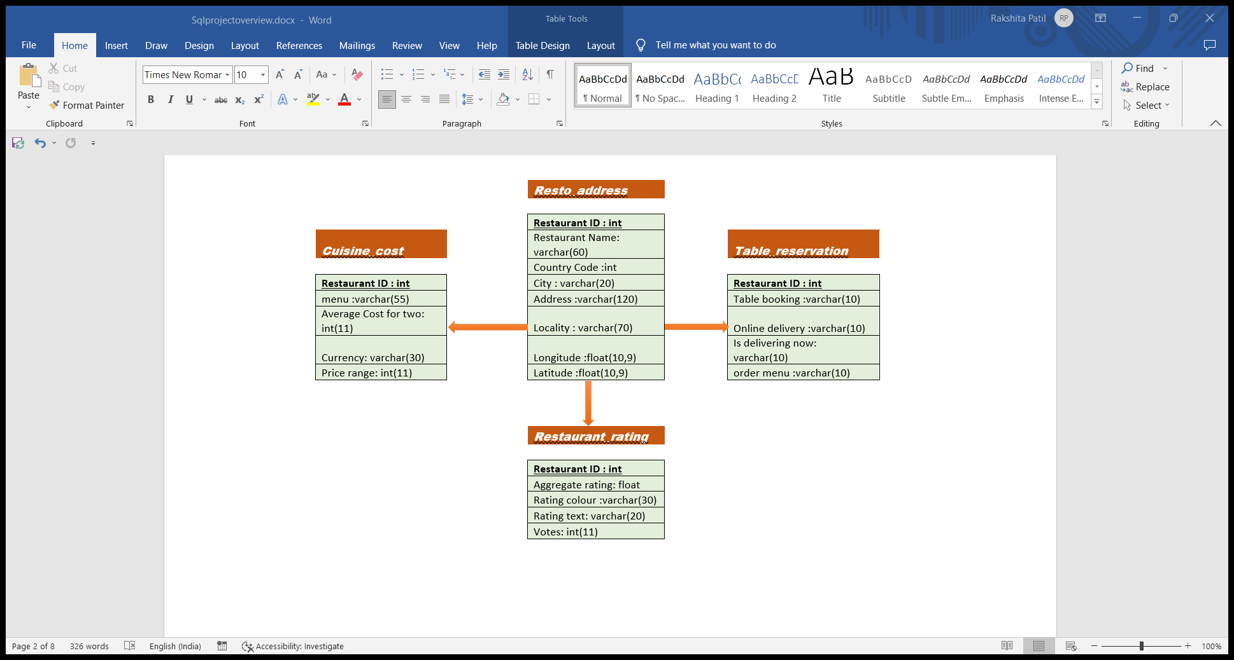
ER DIAGRAM

Slide 4
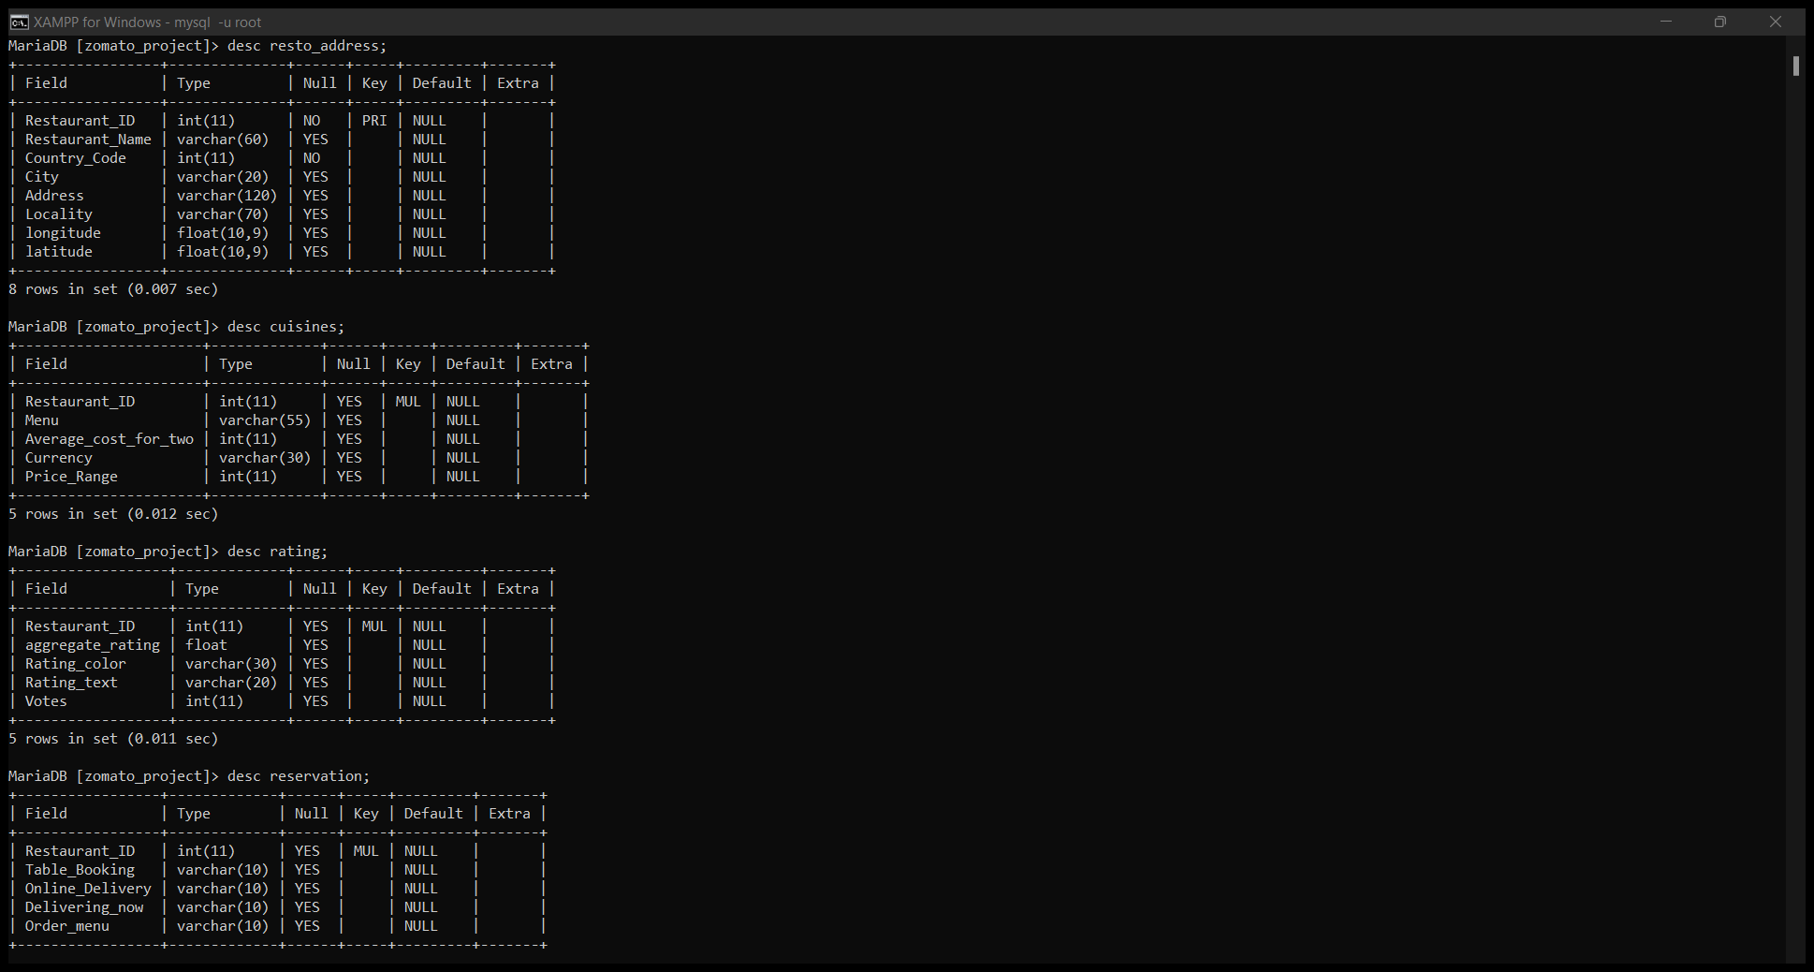
Structure of Relations

Slide 5
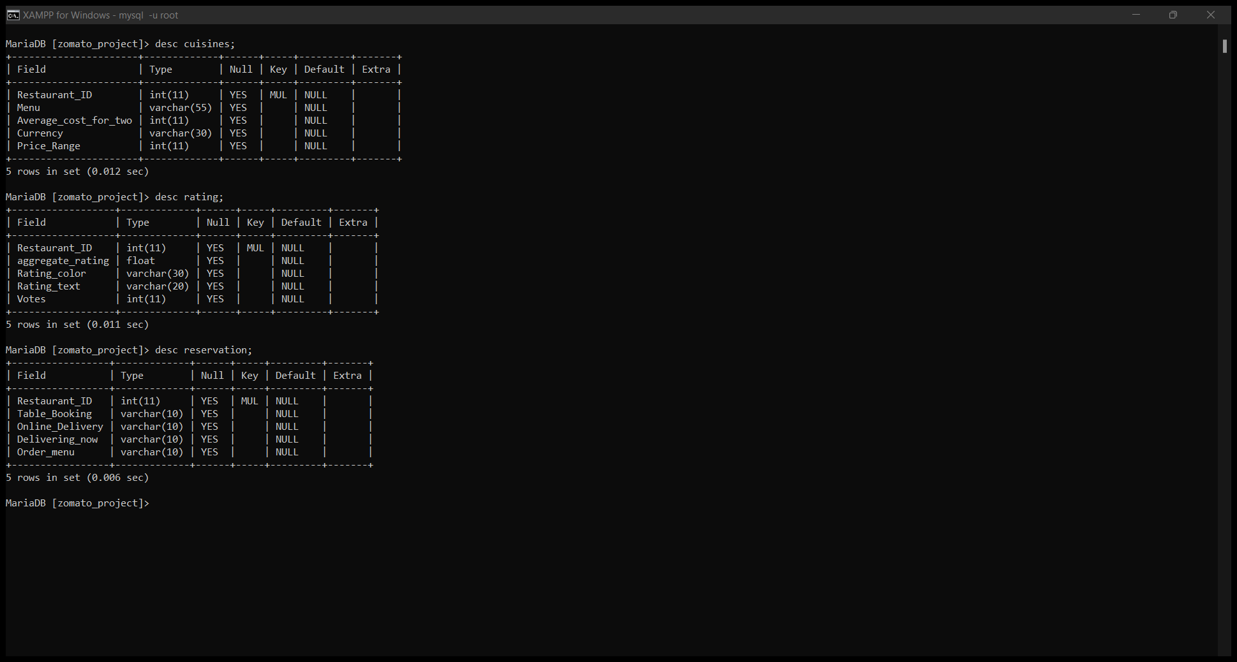

Slide 6
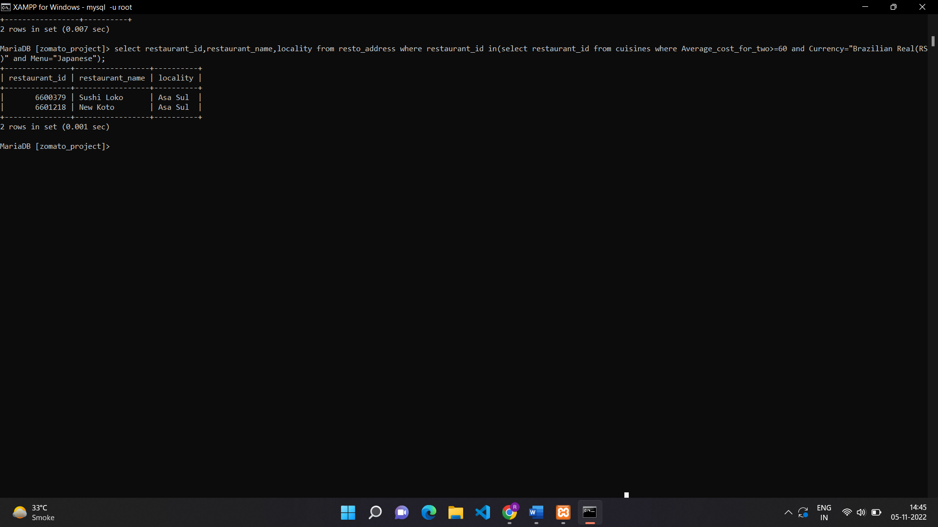
Subqueries
Find restaurant name and their locality according to country where price for two is at least 60 Brazilian Rs and offers Japanese food.

Slide 7
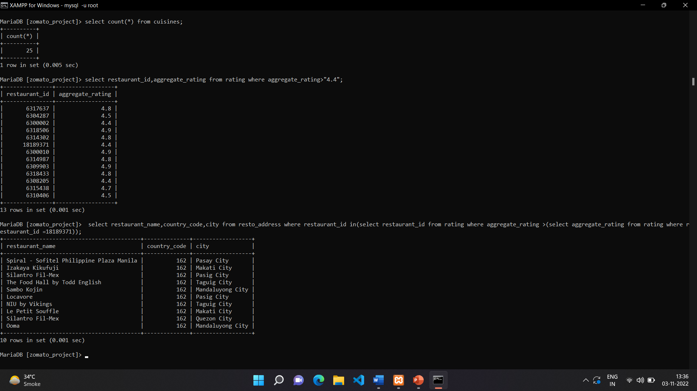
2.select all the restaurant with their corresponding country code and city name whose rating is greater than rating of restaurant whose id is 18189371.

Slide 8
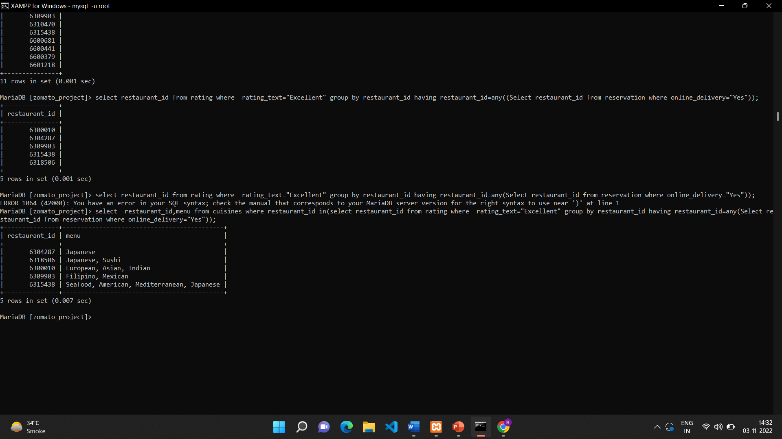
3.Cuisines of hotels with their id who has excellent review and are having online delivery.

Slide 9
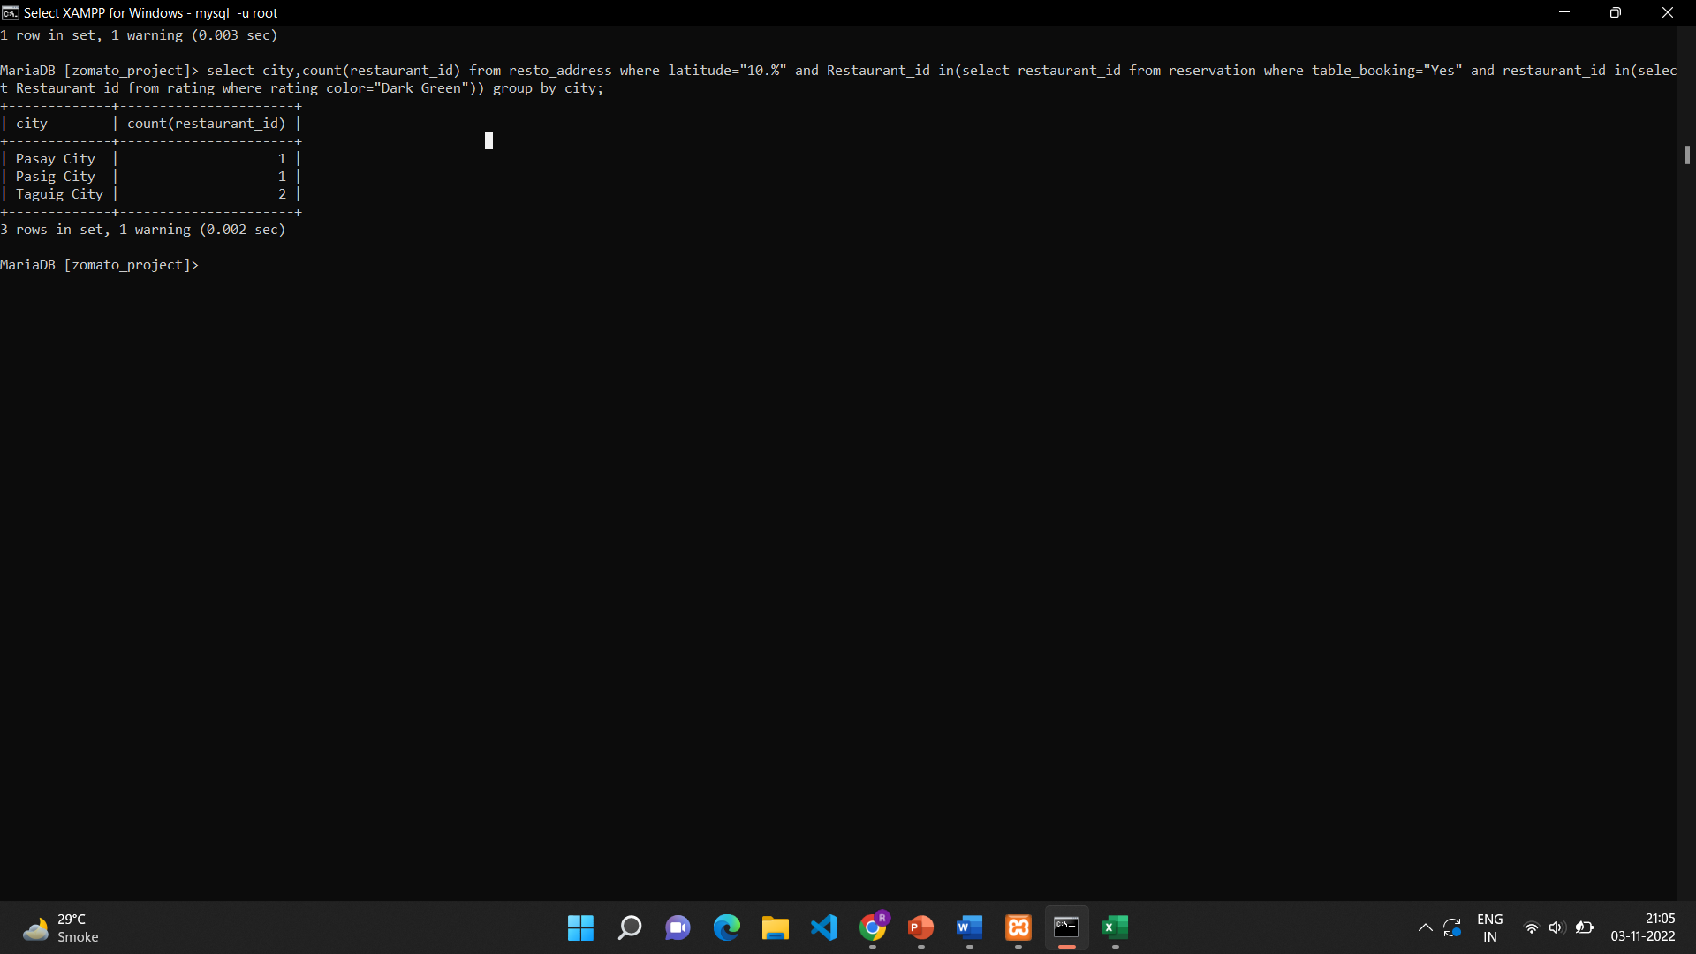
4.give count of restaurant according to city that are situated around a 10⁰ latitude mark Who has table booking but rating is denoted by dark green colour

Slide 10
Joins

Slide 11
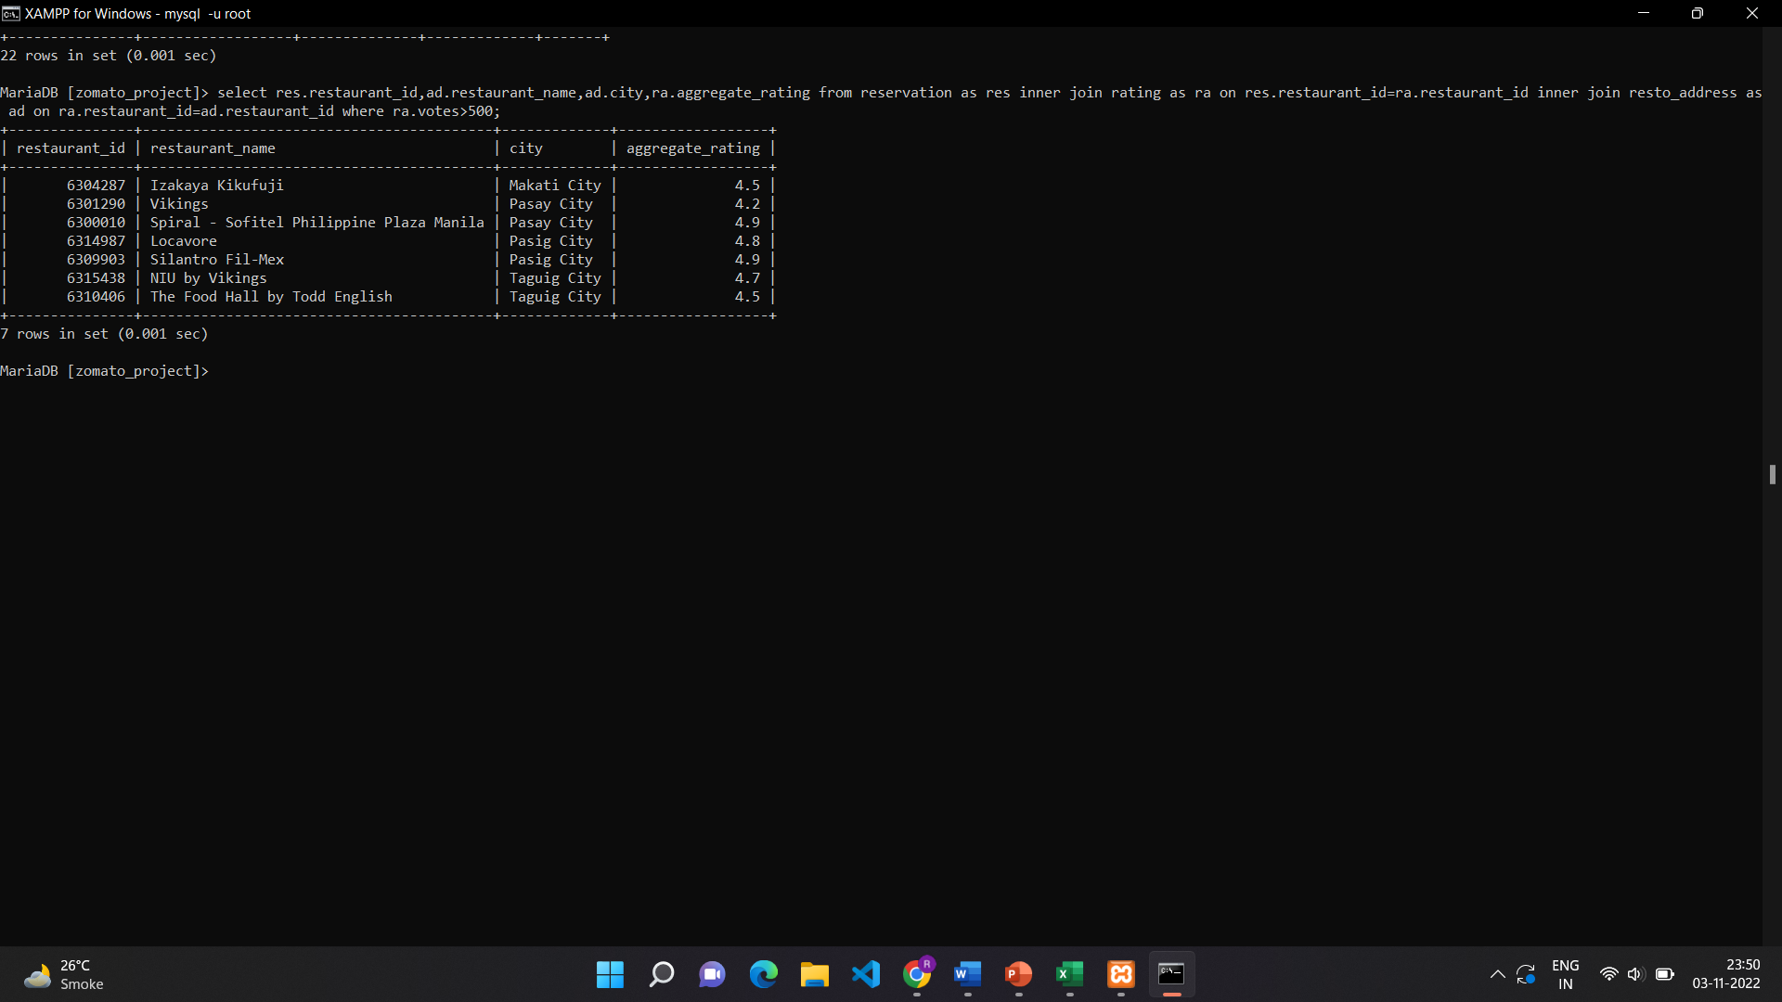
1.Give restaurant id, name , city and rating whose vote are greater than 500.

Slide 12
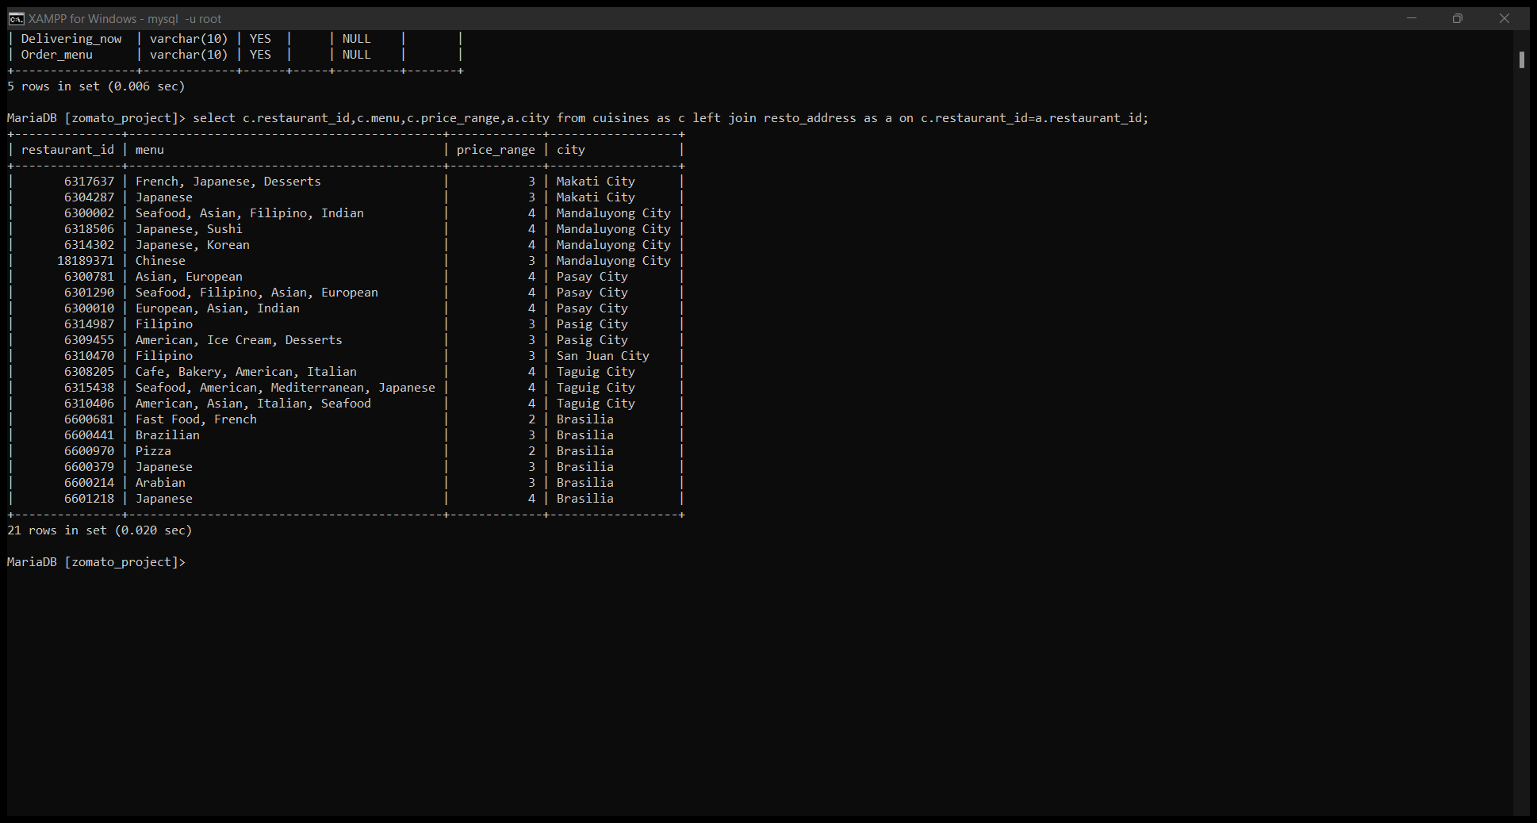
2. Give cuisines of restaurant that are available with their price range ,city.

Slide 13
Views

Slide 14
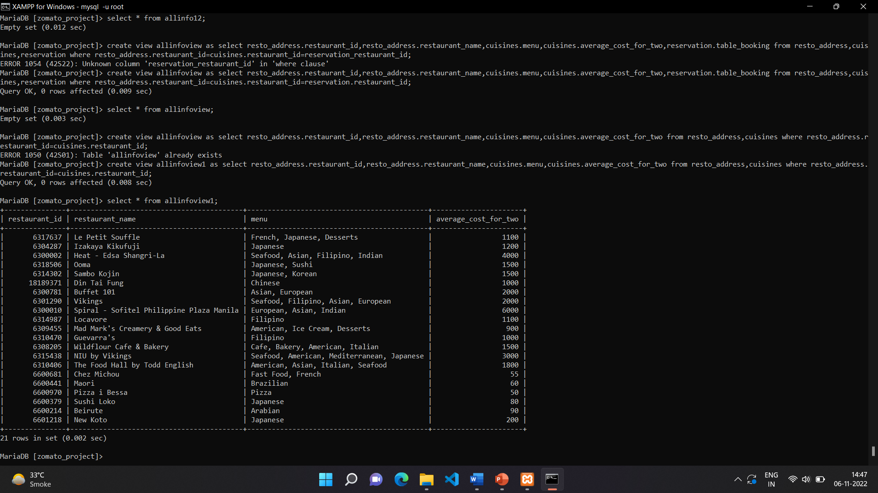
Create a table where restaurant id , name ,menu ,cost , table booking ,aggregate rating.

